Slide 1

Virtual Workshop Best Practices and Housekeeping
April 13-15, 2020
Fishery Productivity Workshop 2020:
Measurement, Data Sources, and the Pattern of Growth
Silver Spring, MD/Remote
[INSERT CALL IN INFO]

Slide 2
Outline
Welcome to WebEx!
General best practices
What participants roles look like in the virtual world
How to participate
Troubleshooting potential issues

Slide 3

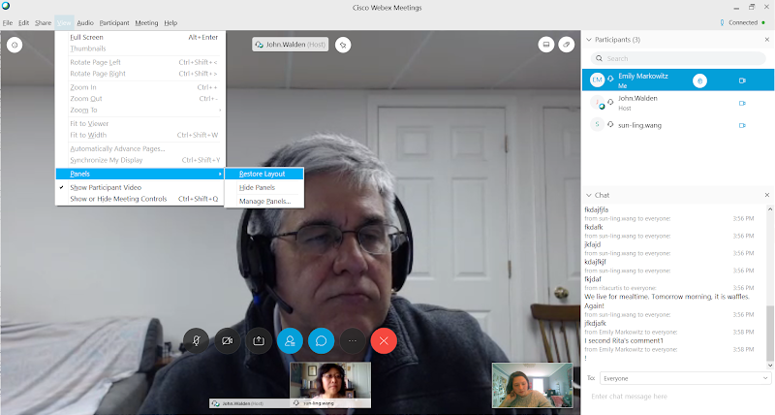
Welcome to WebEx!
Please note that this meeting will be recorded and transcribed.
“Raise hand”
Participant panel
Tabs with other meeting controls
Chat panel
Audio, video, and screen controls.
Video of participants

Slide 4

Best Practices:
Golden rule:
Please keep on mute and video off when not speaking
Helps preserve bandwidth for organizers, moderators, and presenters
Less distracting others attending the workshop!
Move house phone out of the room and turn cell phone to vibrate

Slide 5
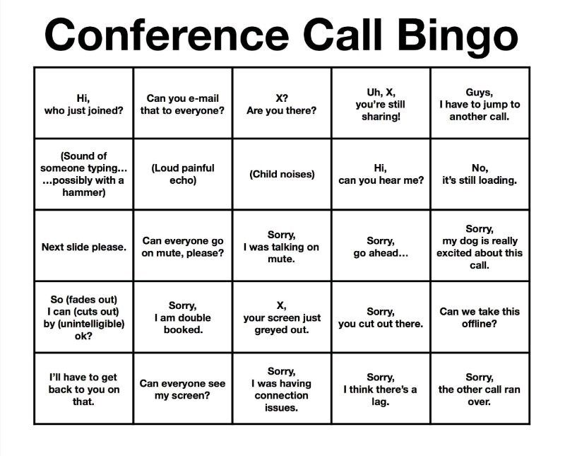
Don’t Call Bingo!
Notes:
Theres a lot we can do on our ends to minimize distractions and help keep focus on the presenters. These are just a few things that we have ALL experienced while listening in or presenting on video chats or teleconferences. Point is, be mindful of background noises at home and try to be as prepared as you can. We are all learning in this new crazy COVID19 world!

Slide 6









Participant Roles: Host/Organizer
Assign roles to each participant as needed throughout the workshop.
Assist with any technical issues.
Help moderators keep on time.
Be a resource to anyone who needs help ☺
Meeting Organizer: Sun-Ling Wang; sun-ling.wang@noaa.gov
WebEx Host: Emily Markowitz; emily.markowitz@noaa.gov

Slide 7

Participant Roles: Moderator
Make sure the presenter is online and does not have any connectivity issues via private chat.
Collect questions for presenters during and after the presentation for the presenter.
Ask participant questions as time allows.
Keep presentations on time.
Take notes on content and Q&A for workshop summary report.

Slide 8


Participant Roles: Presenter
When it’s time to present, the host will change their status to “presenter.”
Presenter will need to turn off mute, turn on video (so we can see you as you talk), and share your screen.
Questions will be taken at the end and curated for you by the moderator.

Slide 9

Participant Roles: General Participants
To limit distractions and maximize bandwidth:
Stay on mute.
Turn off video.
Do not share your screen.
Use the chat when you have something to say to everyone publicly or privately to another participant.

Slide 10
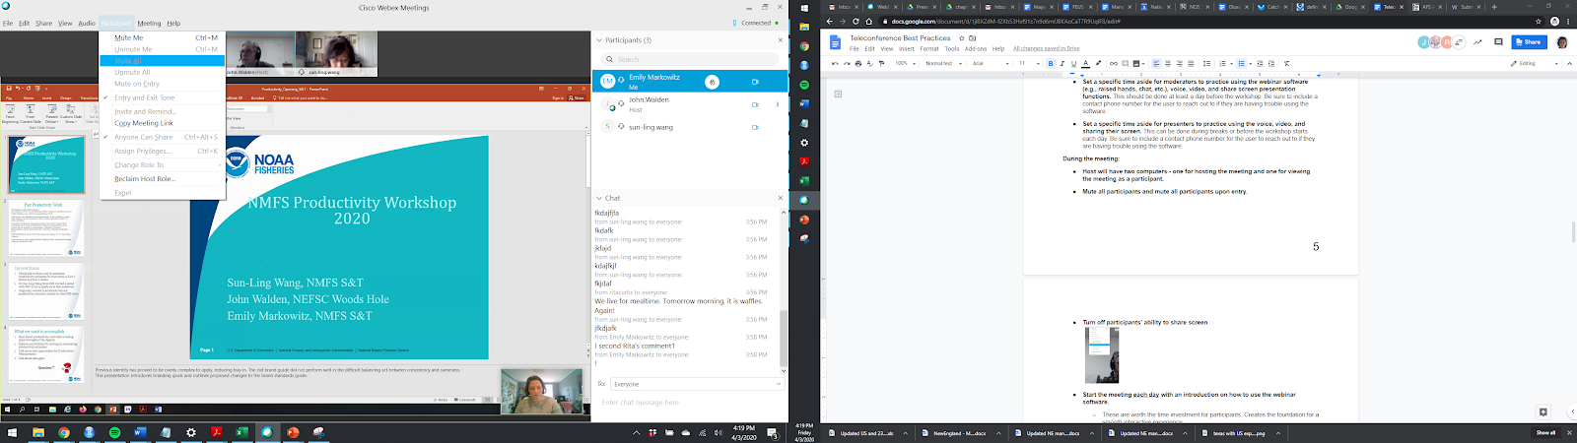
How to Ask Questions:
Click the “Raise Hand” button next to your name in the “Participants” panel.
Share your question in the chat so everyone can see it. The moderator will record your question and ask the presenter your question for you after the presentation during the Q&A.
Don’t forget to address who the question is for!
Any question that is not answered during the Q&A or asked after the Q&A will be shared with the speaker by the moderator. The speaker will respond back later.
Hi Emily: Why did you choose option A for your analysis?
To Rita’s question: Great question! It was really the best choice considering our study constraints. …

Slide 11
How to Add to a Discussion:
On the third day, the workshop will mostly consist of discussions.
When any participant has a question or comment, they can raise their hand. When the moderator calls on you, feel free to:
Turn mute off, video on, and if relevant, share your screens.
Entering questions or comments into the chat box.
The moderator will be looking for your input!
Please turn these off whenever not speaking.

Slide 12


Troubleshooting Potential Issues
If you are having trouble accessing the meeting:
Try a different web browser. Chrome is usually good to use.
Try signing out and back in.
Open the download directly from the “Downloads” folder, not the link from the bottom of your web browser.
Find an alternative way to access the meeting (e.g., phone line).

Slide 13
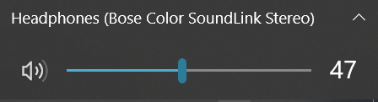
Troubleshooting Potential Issues
If you are not hearing anything:
Check your speaker symbol is not on mute.
Make sure the correct sound source is being used.
Ask in the chat if others can hear the presenters.
If you lose a panel and want it back:
Click the “View” tab, choose “Panels” and “Restore layout.”
If all else fails, contact the meeting host.
Emily Markowitz; emily.markowitz@noaa.gov
Sun-Ling Wang; sun-ling.wang@noaa.gov

